Slide 1
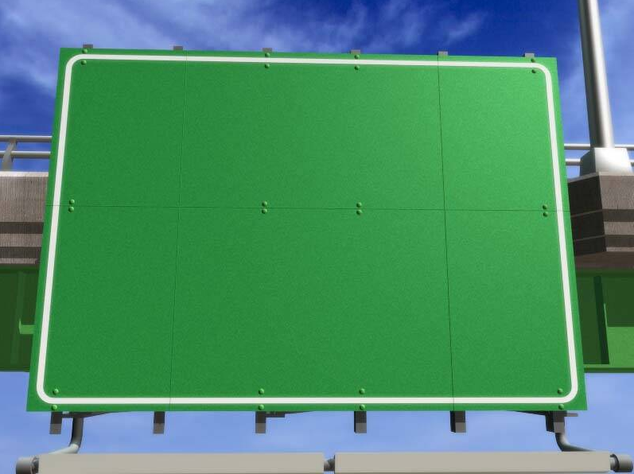
Caltrans Traffic Operations
An “Outsider’s” Perspective

Slide 2
Introduction
As the State Highway transportation system nears maturity, the focus is shifting to optimizing travel and safety across all modes for people, goods, services … and data (broadband).
Technology, specifically an intelligent transportation system, will be a key to achieving this goal.

Slide 3
II. Some of the Current Efforts Under Way

Slide 4
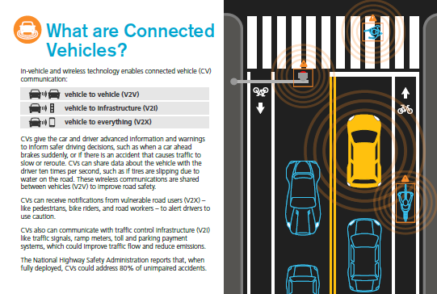
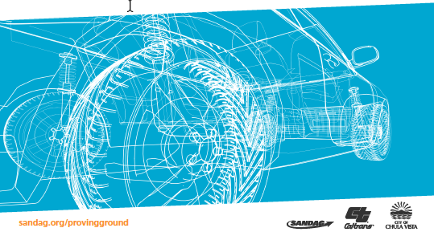
SAN DIEGO REGIONAL PROVING GROUND
Connected and Autonomous Vehicles

Slide 5

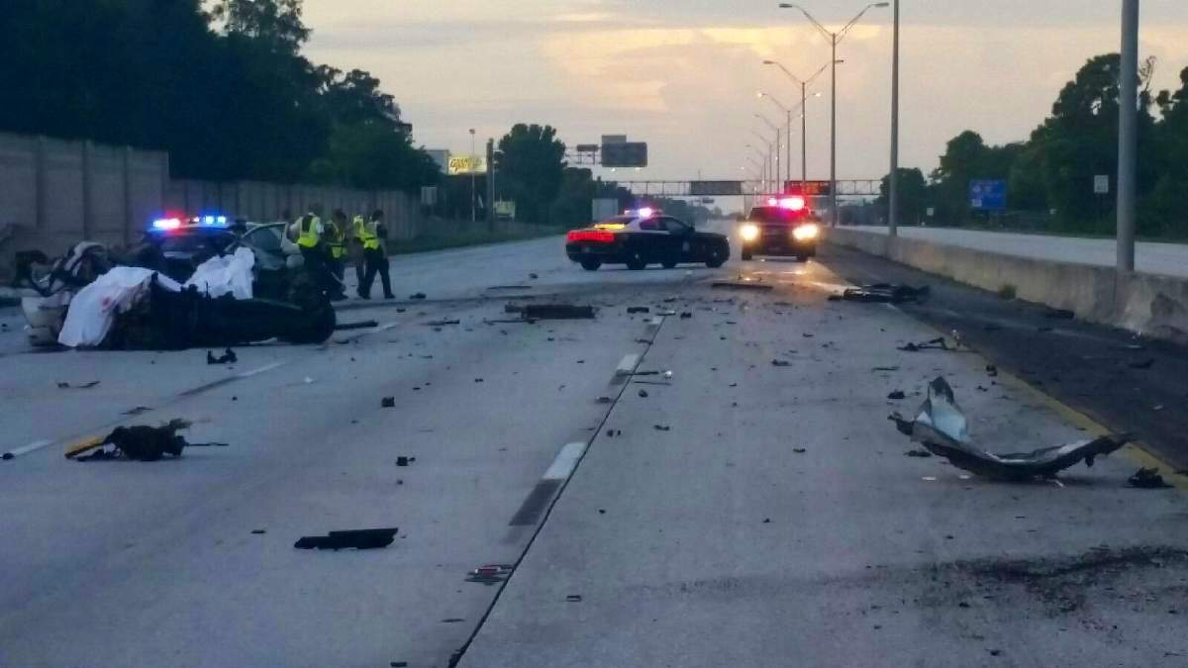

WRONG WAY PILOT PROJECT

Slide 6
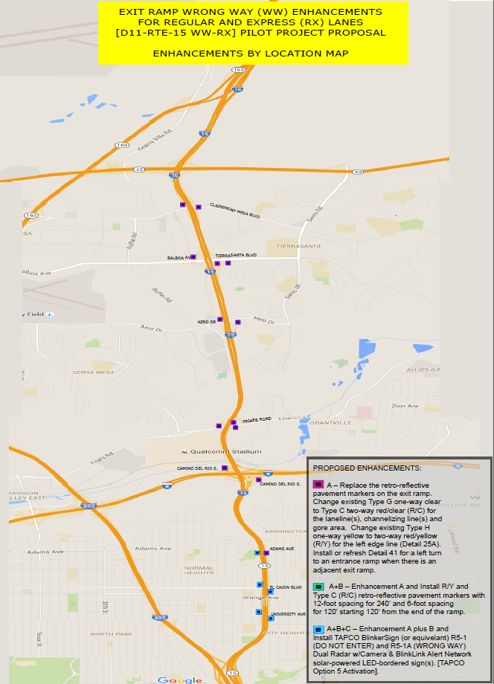
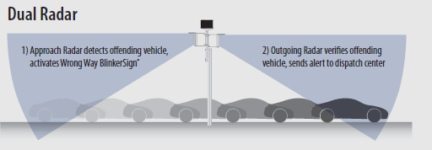
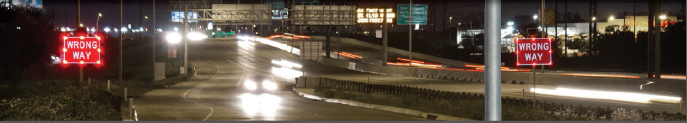
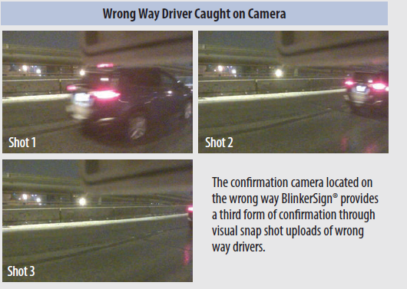

Slide 7
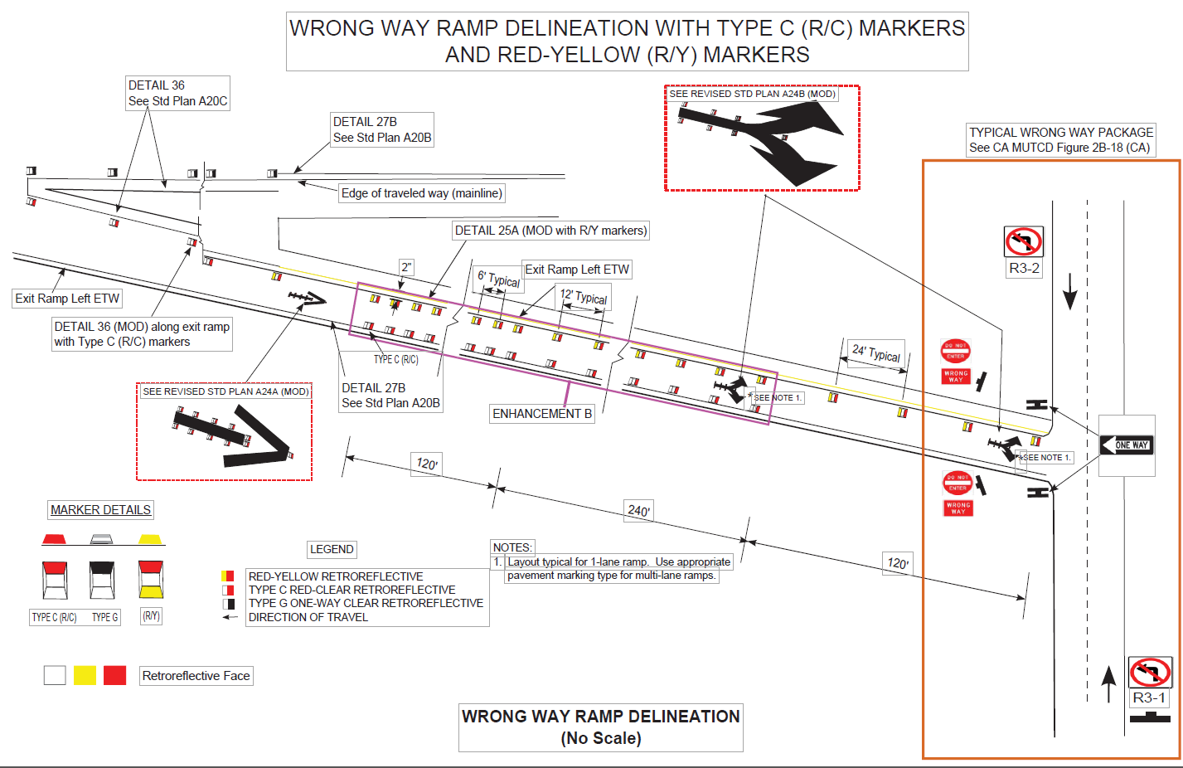

Slide 8
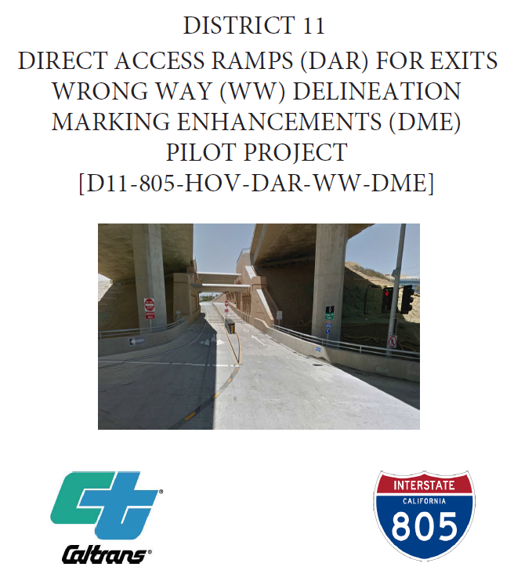
ROLLING OUT WW PILOT TO OTHER CORRIDORS
Implementing pilot projects at Carrol Canyon Road interchange and East Palomar Street Overcrossing DAR projects.
Installation of enhanced wrong way markings at above ramps.

Slide 9
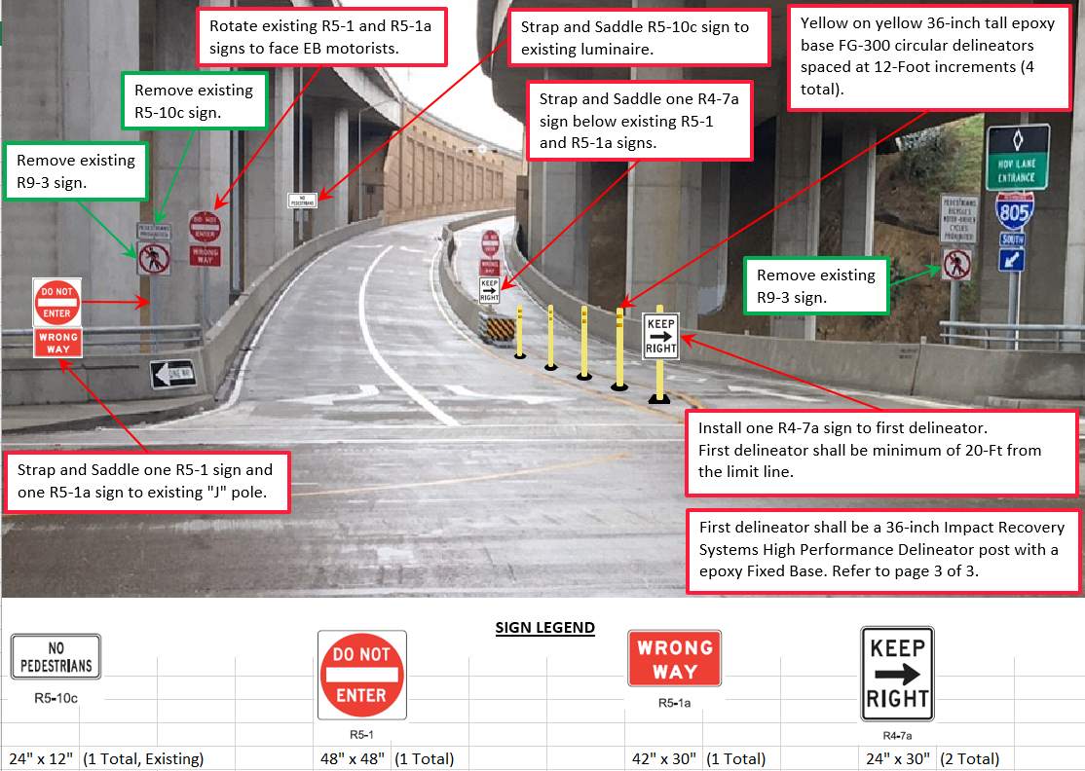
Proposed sign changes

Slide 10
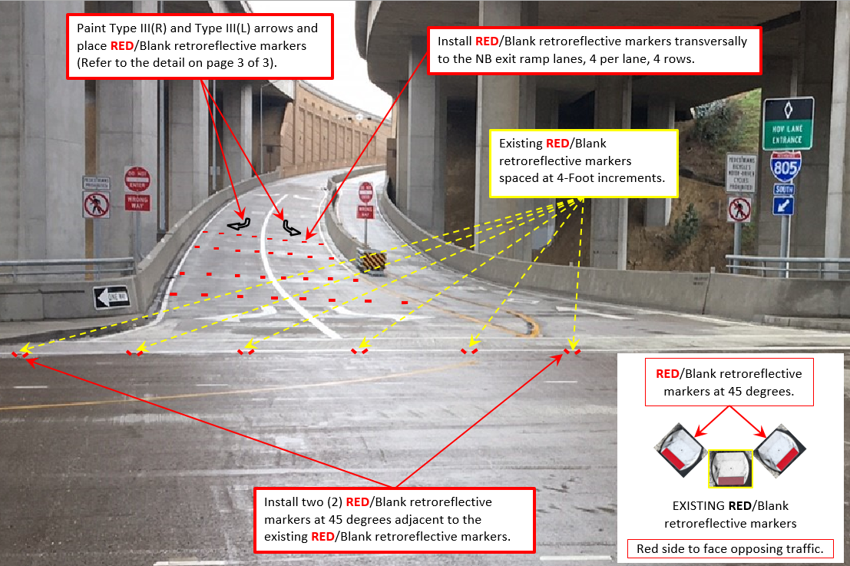
Proposed Pavement Markings, 1 of 2

Slide 11
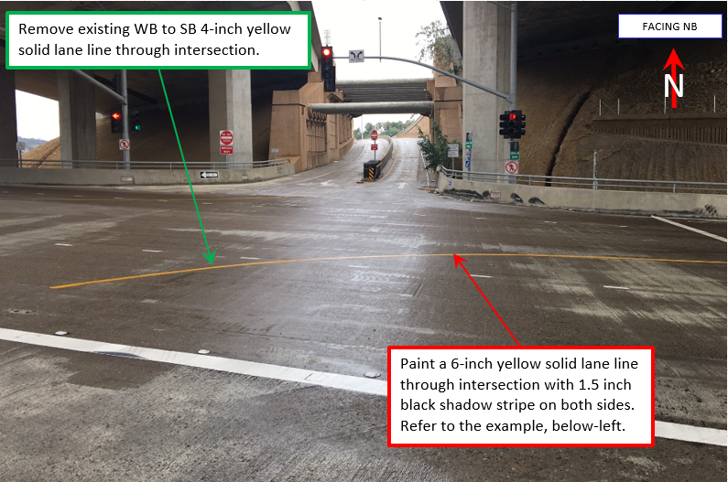
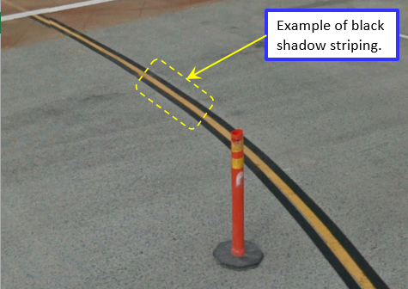
Proposed Pavement Markings, 2 of 2

Slide 12
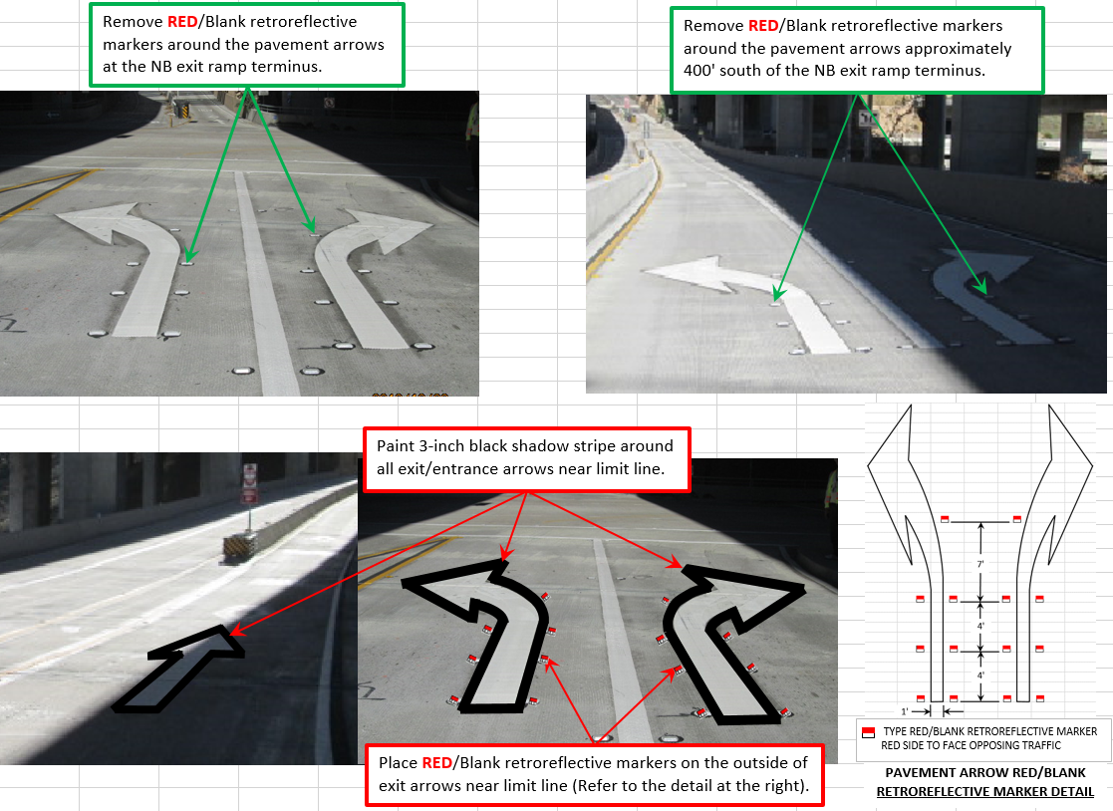
Pavement Arrow Changes

Slide 13

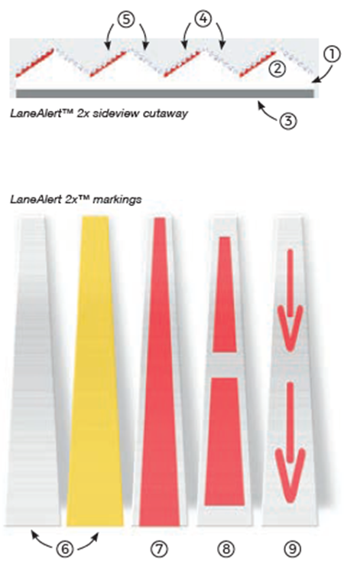
Signing and Striping

Slide 14
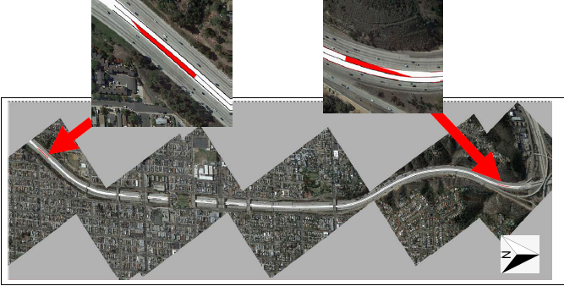
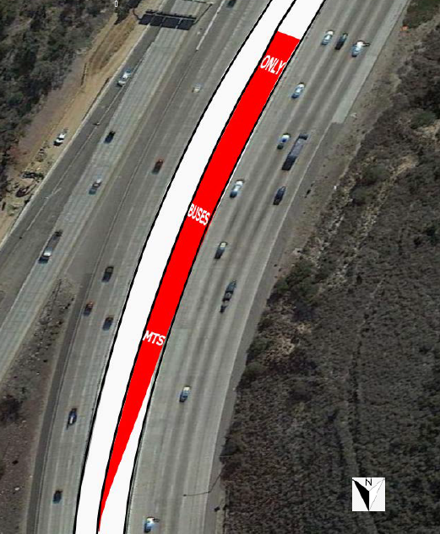
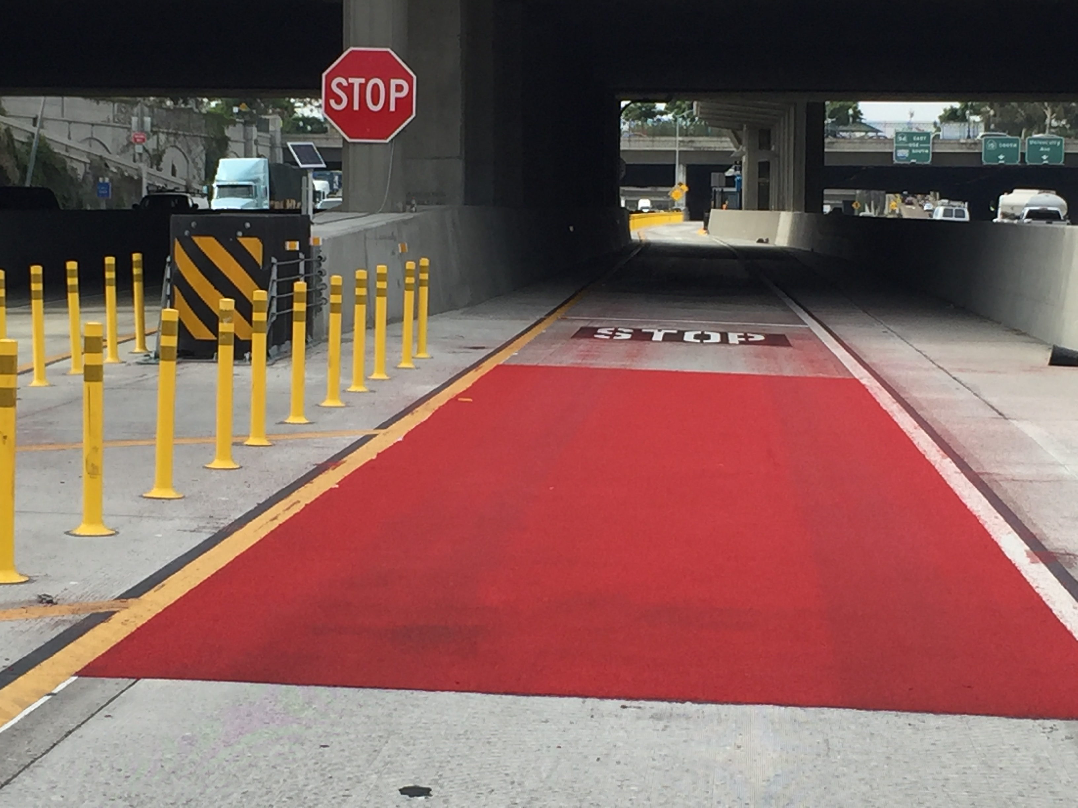

Slide 15

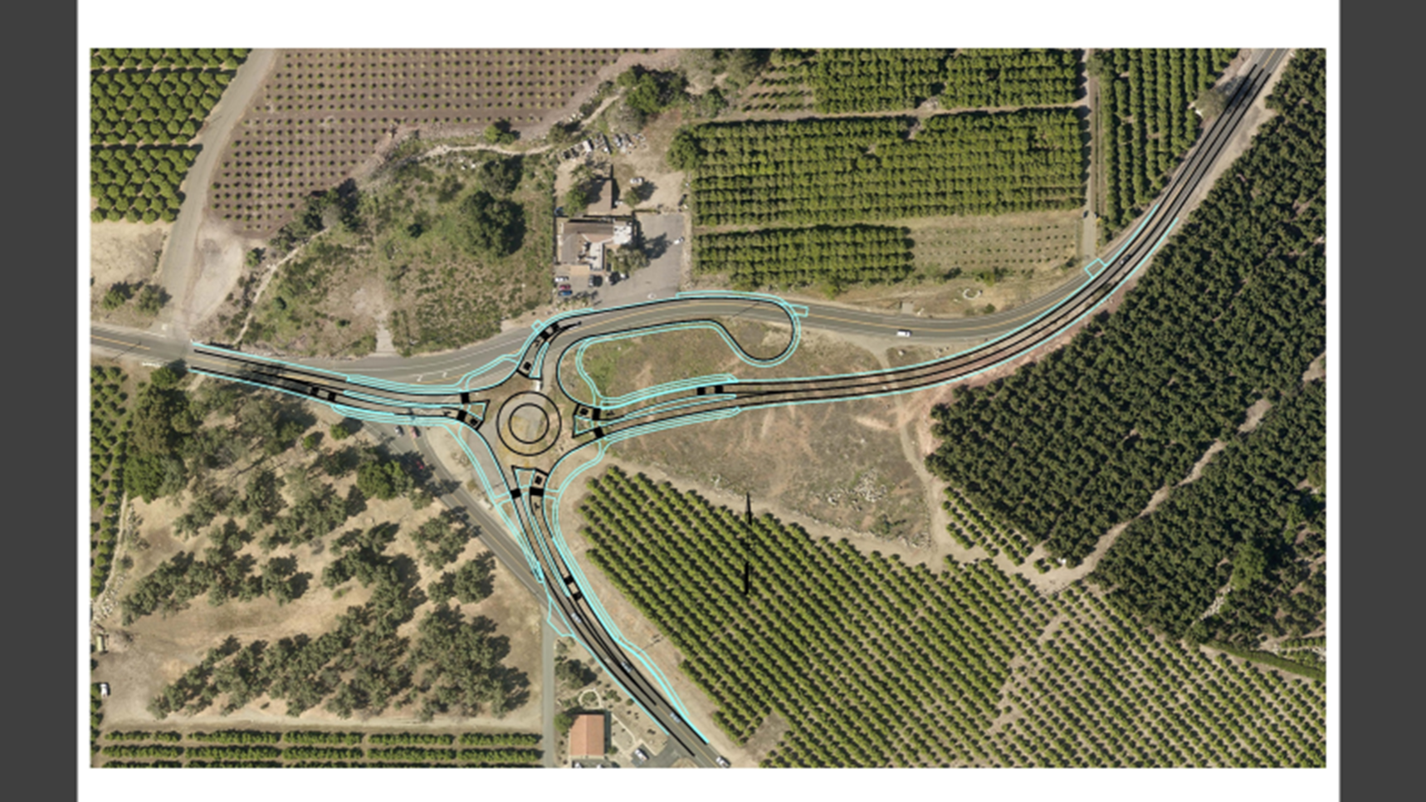

Slide 16
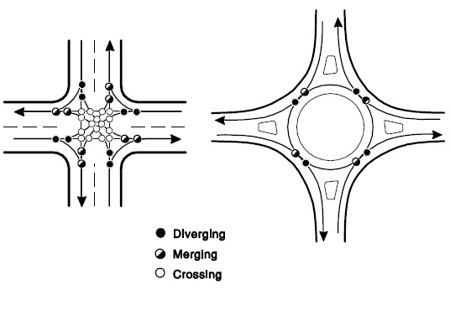
Conflict Points
The number of vehicle conflict points for roundabouts vs. conventional four-leg intersections decreases from 32 to 8 – NCHPR Report 672
Notes:
In a typical signalized intersection, there are 32 potential conflict points.
In a roundabout there are only 8 conflict points.
This is mostly because, in a roundabout, all movements are converted to right turns, eliminating the crossing conflicts.

